Slide 1


FITNESS TRACK
By
Satya Chowdary gullapalli
Swarupa pedapalli

Slide 2
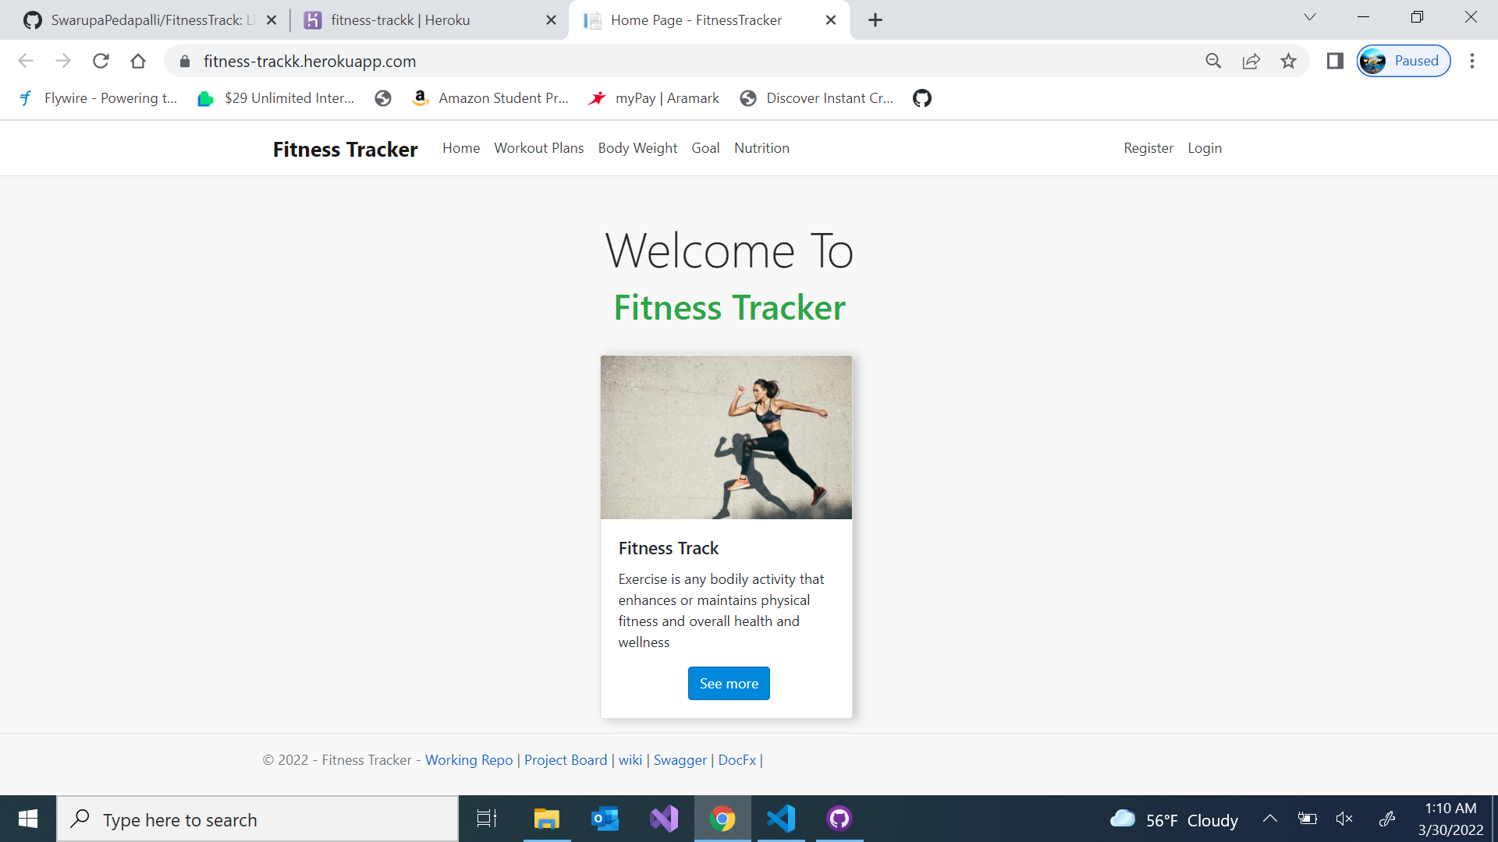

Finding our app on the web HEROKU https://fitness-trackk.herokuapp.com/

Slide 3

Why this app? Our app helps us in keeping up a track with our daily Fitness Activities where user could see what workouts a person would do for that particular day and whole week. they can also check their progress of activities, body weights, nutritional goals .

Slide 4
Who will use it?
People with good motive to workout hard and track their daily activities.

Slide 5
what is the main purpose
The main purpose of this application is to track the fitness activities of the user, which helps the user maintaining a healthy life-style

Slide 6





Tech stack Frontend: c# Backend: .net Database: Mysql Deployment : Heroku

Slide 7

Why this stack we used java/spring boot with angular in our gdp1. to explore a new stack this time, we tried C# with .net and acquired many technical skills on it.

Slide 8

Lessons learned 1.GitHub-Issues,milestones,Wiki,Actions, Project board 2.codacy 3.sonar cloud 4.UNIT TESTING 4.swagger 5.documentation 6.STACK,DEPLOYMENT,DATABASE

Slide 9
1. Github – we learned creating an issues, milestones and resolving them. 2. Codacy - Codacy helped us to review the code and monitor the code quality on every commit and pull request . 3. SonarCloud - By using SonarCloud, we learned to catch Bugs and Security Vulnerabilities in the Pull Requests and throughout the code repositories.
4. Swagger – We learned to design, build, document, and use RESTful web services. Swagger also helped us in automated documentation and test-case generation.
5. DocFx - DocFX is an API documentation generator for . NET. We learned building a static HTML website from the source code and Markdown files.

Slide 10

GITHUB: https://github.com/SwarupaPedapalli/FitnessTrack HEROKU: https://fitness-trackk.herokuapp.com/ DOCUMENTATION: https://github.com/Satyachowdary97/FitnessTrack-document SWAGGER: https://github.com/Satyachowdary97/Swagger-Fitness-Track CODACY: https://app.codacy.com/gh/SwarupaPedapalli/FitnessTrack/dashboard?utm_source=github.com&utm_medium=referral&utm_content=SwarupaPedapalli/FitnessTrack&utm_campaign=Badge_Grade SONARCLOUD: https://sonarcloud.io/summary/new_code?id=SwarupaPedapalli_FitnessTrack

Slide 11

Release https://github.com/SwarupaPedapalli/FitnessTrack/releases/tag/v1.0

Slide 12

THANK YOU

